Slide 1
Texas Community Development Block Grant Program
Payment Request in TDA GO!
Notes:
Good afternoon and thank you for joining us for today’s CDBG Over Coffee. Today’s topic is Request for Payment in TDA GO! I’m Jeanette Chardon-Martinez and I am Contract Specialist for the Texas Community Development Block Grant Program. Also joining me on the line are my colleagues:
A couple housekeeping items before we get started.
Please mute your lines and feel free to use the chat feature to ask questions. We’ll also take general questions after the presentation, but if you have project- or community-specific questions, please reach out via email.
Let’s get started!

Slide 2
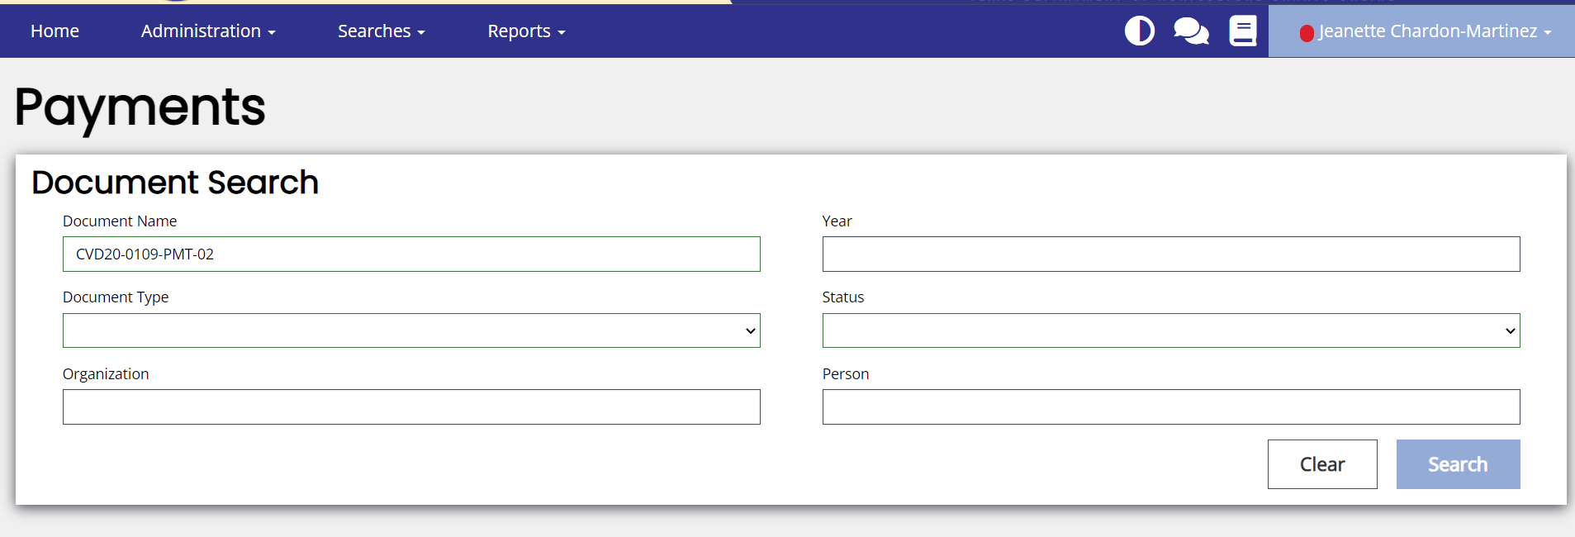
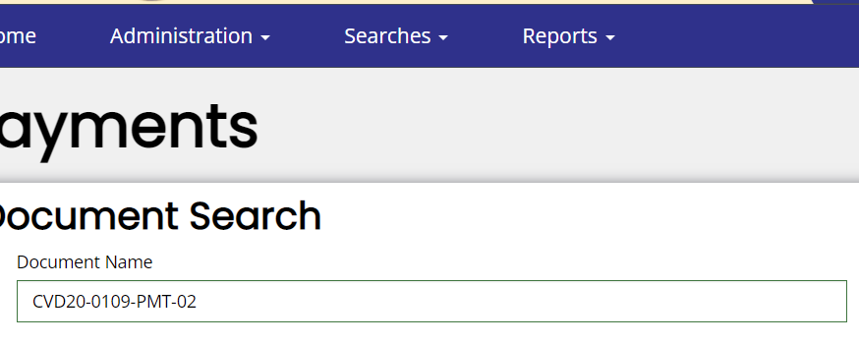
Submitting a Payment Request
After logging in:
Click on the Searches button and type in the name grant agreement.
Notes:
After logging in TDA GO! Go to the navigation bar and click on Searches. On this page you will be able to type your grant agreement name and find the contract.

Slide 3
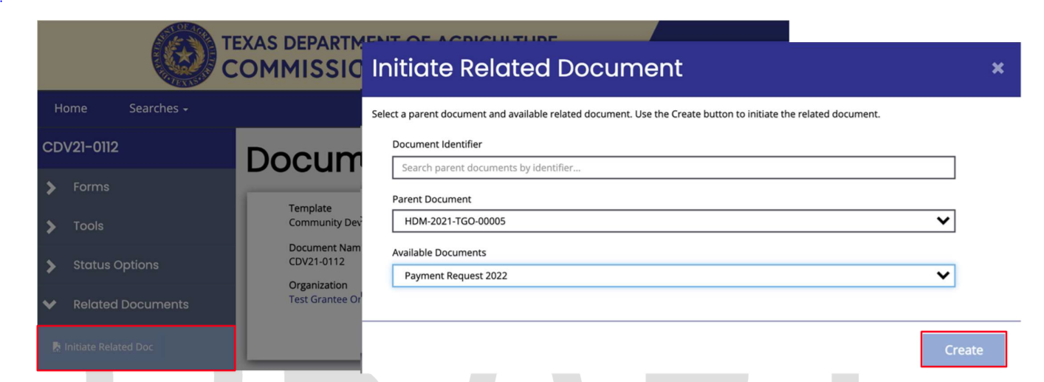
Initiate Related Document
On the side bar, navigate to the Related Documents tab and select Initiate Related Document. In the pop window, under the Available Documents field, select Payment Request and select the Create button.
Notes:
Once you have located your grant agreement, on the side bar, navigate to the Related Documents tab and select Initiate Related Document. In the pop window that appears, ensure that the correct Parent (Grant) Number is selected. Next, under the Available Documents field, select Payment Request and click on the Create button.

Slide 4
Payment Request Summary
Make sure to review the Summary page to confirm the balance available for each detailed budget row. Once review is completed, click on the Itemized Invoices List.
Notes:
Now, you are in the CDBG Payment Request Summary page. Make sure to review the Summary page to confirm the balance available for each detailed budget row.
Your budget might look slightly different then the one submitted in your application. TDA staff may separate an activity budget into two or more separates rows in this table to more accurately document the funds allocated to the project and the appropriate codes.
Once review is completed, go ahead and click on the Itemized Invoices List.

Slide 5
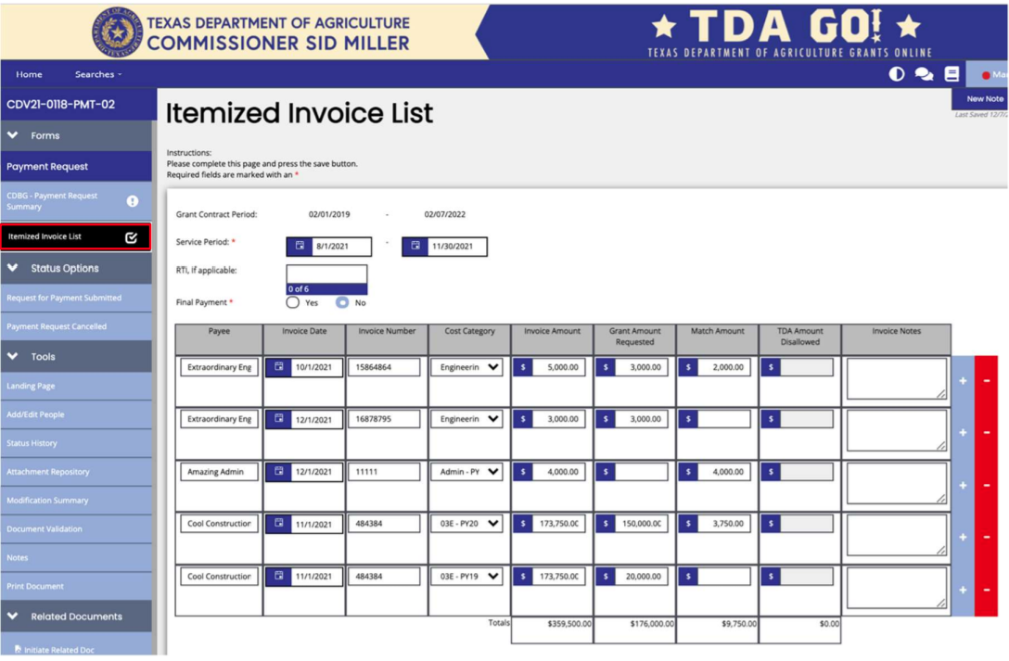
Itemized Invoice List
After reviewing the budget select the Itemized Invoice List and begin entering information for the payment request.
Notes:
First is the Service Period. Enter the earliest and latest dates covered by the invoices included in this payment request.
Underneath is the RTI – This field will be left blank.
If this is a Final Payment – Select YES only if the balance for all detailed budget rows is $0.00, or if the Grant Recipient intends to deobligate the balances remaining. The final decision on deobligation of funds will be made during the closeout process, but this response on the payment request helps TDA provide technical assistance and make funding decisions.
When ready to enter the amounts, enter the amount of each invoice to be included in the payment request. Create a new row by selecting +.
For EXAMPLE: If you only have one invoice for administration for the month of March, create one a row for the invoice, but let's say you have two invoices for engineer one for March and one for April, now you will create one row for the March invoice and a second row for the April. Make sure to enter the correct invoice number and amount on the row. Do NOT subtotal invoices even if for the same payee, unless directed to do so.
When an invoice has multiple cost category, you will need to select the appropriate category for each invoice based on the detailed budget row.
For EXAMPLE: If a construction invoice includes costs for Activity 03J Water/Sewer and Activity 14A Rehab Utility Connection, create two rows—the grant amount requested and match amount fields for the row where the 03J cost category is selected must only include 03J costs, while the row with 14A selected must include the 14A costs only in these two fields.
• Upload invoices or similar backup documentation to support each row listed. You can use the same invoice, but do not use the same label name. EXAMPLE: Construction 1, Construction 2, Engineering 1, Engineering 2.
• Select the Save button in the upper right corner of page, then
• Select the CDBG Payment Request Summary tab. Verify that balances appear as expected.

Slide 6
Payment Request Summary
Verify that balances appear as expected.

Slide 7
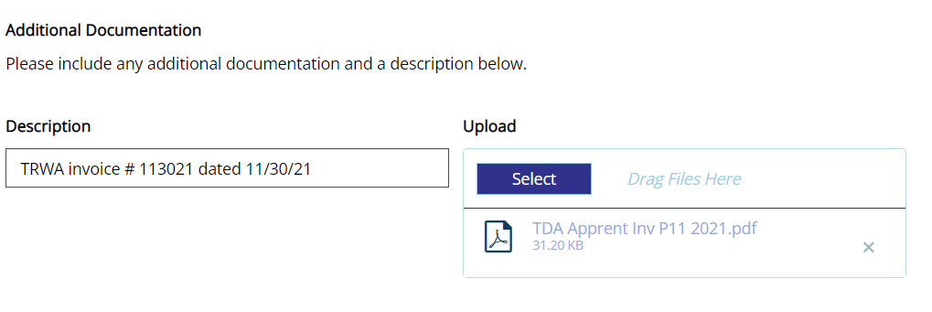
Uploading Your Documents
All backup documentation that will justify a payment for each activity, including matching funds, must be uploaded to TDA-GO.
Notes:
All backup documentation that will justify a payment for each activity, including matching funds, must be uploaded to TDA-GO.
• All costs must be supported by invoices or similar documentation, which include information regarding the vendor, Grant Recipient, grant agreement number, invoice date, invoice number, service delivery dates (from and from), quantity, price, percentage complete (if applicable), detailed description of goods or services, previously invoiced amount (if applicable), and current amount due.
• Backup documentation included with a payment request must include enough information to confirm that an item is eligible under the TxCDBG grant agreement and that the work billed has been completed.
• Invoices that include costs related to two or more activity budgets, including match, the invoice must clearly indicate how the costs were allocated to the appropriate activity budgets. EXAMPLE: For an invoice that includes both Activity 03J and Activity 14A work, the Grant Recipient might mark with highlighter the specific construction line items that are assigned to the 14A activity budget.

Slide 8
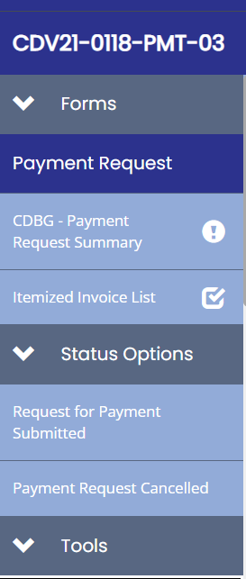
Submitting the Payment
Select the Itemized Invoice List tab and secure two certifications from individuals designated as payment processors.
Navigate to Status Options in left navigation and click on Request for Payment Submitted.
Notes:
Navigate to Status Options in left navigation and select Request for Payment Submitted.
TDA staff will review the payment request promptly. If TDA staff identifies minor revisions to the data, staff may make certain adjustments and note those changes in the TDA Comments box.
EXAMPLE: The payment request exceeds a funding threshold that has not been satisfied, but the costs are otherwise eligible, the Grant Specialist will reduce the grant amount requested and note the amount which may be claimed on subsequent payments. If costs included on the reported invoice are not eligible for the TxCDBG program, TDA staff will indicate by noting the disallowed amount in the appropriate column and reducing the grant amount requested. Under no circumstances will any TDA staff member increase the amount of grant funds requested on behalf of the Grant Recipient. If additional costs can be claimed, TDA staff may return the payment request to be revised and recertified by the Grant Recipient.

Slide 9
Initiate Related Document
The Grant Recipient may check the status of the request in TDA-GO by navigating to the same payment request.
Notes:
Once a payment request has been submitted, the Grant Recipient may check the status of the request in TDA-GO by navigating to the same payment request. The document landing page will include the current status of the request.

